Slide 1
Energy for designers
Beam 2019

Slide 2
Cappuccino Energy?
47 kcal
197 kJ
(per 100 ml)
12 minutes vacuum cleaning
Smart phone battery: 47.5 kJ = 10 kcal

Slide 3
Program: Today
Getting to know each other
Intro, intro, intro
some thought assignments,
simple circuit,
Doing: paper energy

Slide 4
Tomorrow
Technical stuff
Soldering
Learning about circuit, sensors
making a Joule Thief device
Calculations and Theory

Slide 5
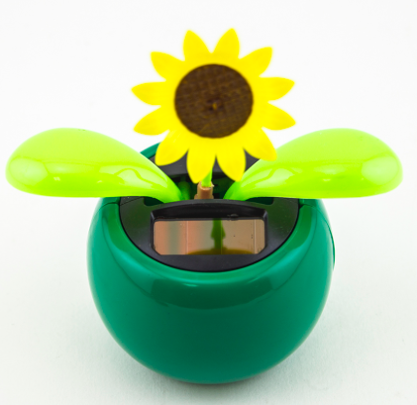
Wednesday
discussion of relevant ideas
example projects
Suggestions
Starting thinking about your own project

Slide 6
Do yourself and present
Thursday, Friday: starting on your own
Monday: checking your plans and experiments
Optional: very short intro Arduino, sensors.
Wednesday tutoring
Friday presenting

Slide 7
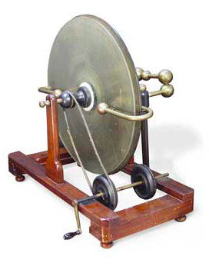
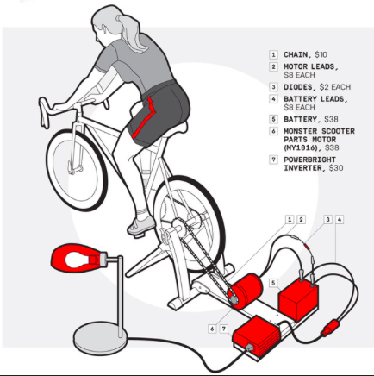
Goal elective
Investigate
Experiment, make, fail
“hands on research”
Do it YOURSELF!
Make something
Use the Stations, Interaction Station, Fabric Station, Metal workshop
Present in person (no tele education) learn from each other

Slide 8
Program - starting part
Day 1: Intro
About the elective
About energy
Big
Small
Very small
Free energy
Stair climbing
Designer Examples
About making
About fake design
Day 2: Basics
Basic electronics, Soldering
Basic calculations, numbers
Batteries, 3V, 1.5V, power of a battery
Lipo, power cells
Joule Thief experiments - boosting voltage
Potato battery
Mud Algae, plant - cell battery
Bike dynamo set up
Hand charging devices IKEA made
Solar cell examples IKEA
Day 3:
Discussing assignment suggestions
More on the examples
Making a choice
Making a planning

Slide 9
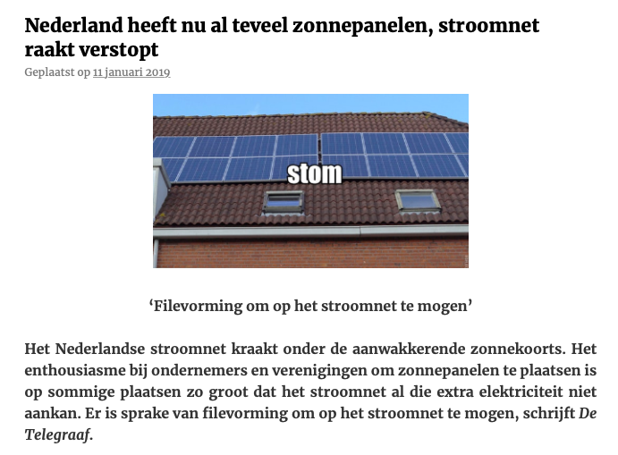
Last week news: Dispair!

Slide 10
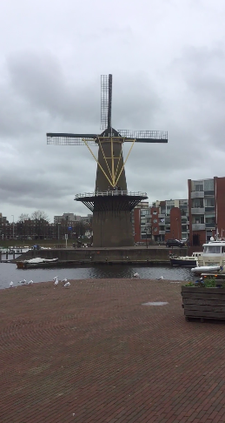
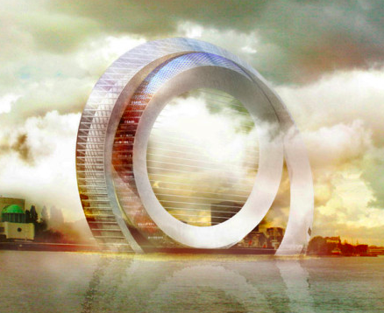
Old Dutch Windmill
Movie! https://www.flickr.com/photos/contrechoc/46761806491/in/dateposted/
Futuristic version
Calculation of a wind turbine (dutch)
http://www.olino.org/blog/nl/articles/2009/05/28/hoeveel-energie-levert-een-windmolen/
https://www.windcentrale.nl/blog/hoeveel-energie-levert-een-windmolen-op/

Slide 11
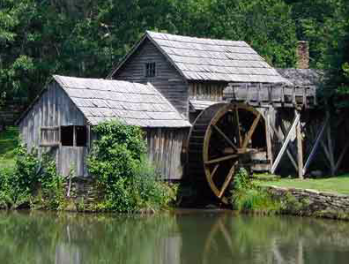
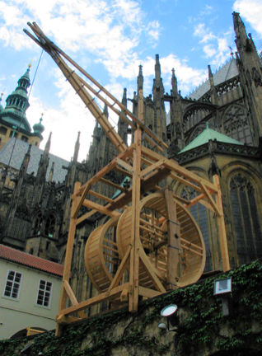
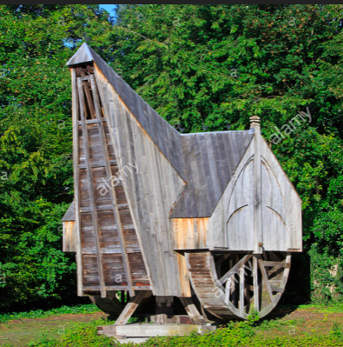
Middle Ages:
(from the dinosaurs till 1992,
that is - no internet)
Water
Wind
Human
Animals

Slide 12
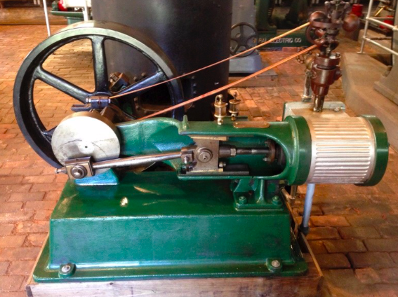
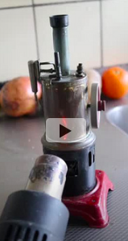
Steam engine
Heating -> movement

Slide 13
Energy ->Movement?
I (and you maybe) thought energy is electricity?
What “shapes”, “forms”, has energy?
What “symbols”, “icons”, “colors” are associated with energy?

Slide 14
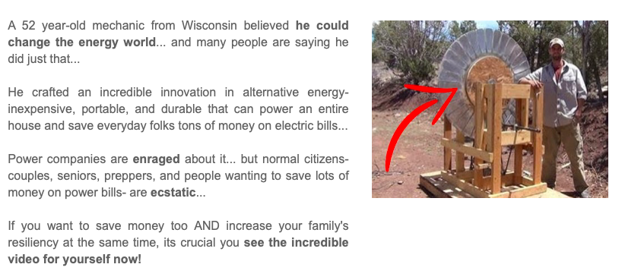
Incredible Claims…
Please believe this! Free energy and so on…..
But look at his “design”…that could be an idea :-)

Slide 15
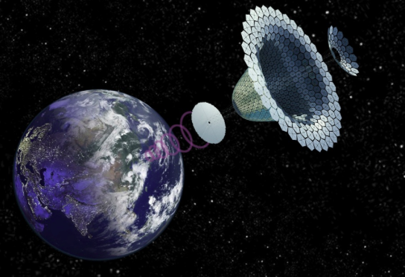
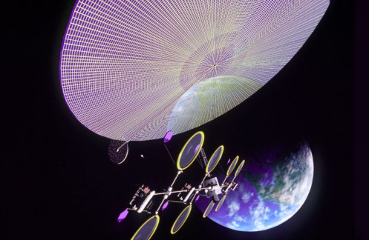
Imagine “Free energy”
What will be the consequence, if there was free energy?
So what about a plan to capture solar energy with a kite as large as the moon and send this energy to the Earth, this is a very good solution for charging everything for free, isn’t it???
But ….it means…

Slide 16
A Now (coffee) assignment
In a group of 5
Imagine (nearly) free energy (say pollution free)
Everybody can make what she wants!
Finally Democracy?
Look at the consequences
(idem, free money free knowledge????)

Slide 17
The subject of (not free) Energy is…
Terribly complicated
Unpredictable, recursive, non linear
There is no one and only “solution”
Many ways to go, multiple “solutions”
All solutions have special problems

Slide 18
Energy
Visible or invisible?
Anonymous, energy is independent of source (like bitcoins)
Wind energy (good) is indistinguishable from nuclear energy (bad)
Is it a Design element, like shape, color, movement?
Ethical? (Being in accordance with the accepted principles of right and wrong that govern the conduct of a profession)
Politics?
Societal problem - world problem

Slide 19
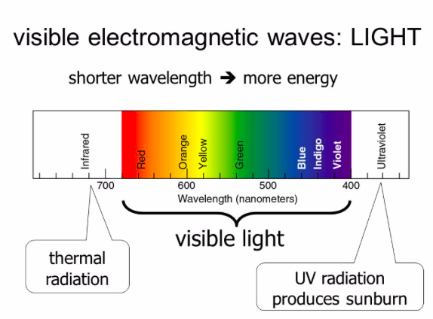
Visible energy

Slide 20
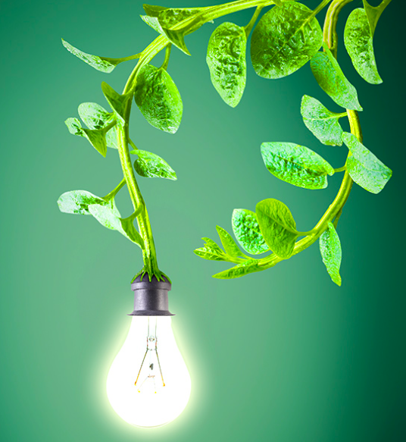
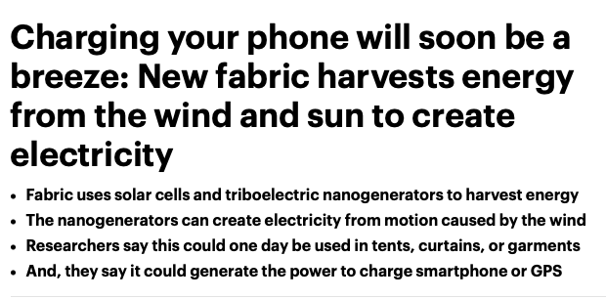
What is more interesting
for a designer
Something that works or something that maybe (not) works
solar cell (works) or a plant (who knows?)

Slide 21
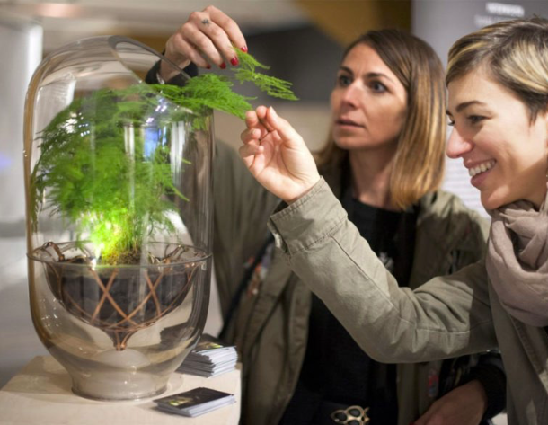
Living Light Ermi van Oers
https://inhabitat.com/this-living-light-is-powered-by-a-houseplant/

Slide 22
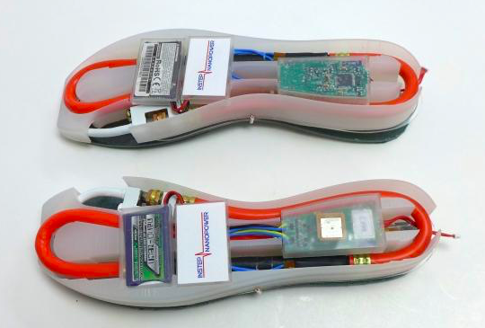
Walking = charging
https://www.tweaktown.com/news/50495/high-tech-shoes-charge-phone-walk/index.html

Slide 23
All my charging devices
Smart phones
Tablets
Laptops
Tooth brushes
Bicycles with accu
Chargeable batteries
Drilling Screwing tool
Electrical vacuum cleaner
Electric violin
“Survival”, living from nature
Sustaining yourself
without electricity
is that possible?

Slide 24
Objects not using energy
Books
Bicycle on leg muscle power
Trees …..(?)
Violin
Hammer

Slide 25
Trees (mysterious!)
Leaves….
Solar cells?
Electricity?
A leaf is making tree building blocks from light and minerals, water
Grass is making grass building blocks, a cow eats grass, humans (but for vegetarians) eat cows…

Slide 26
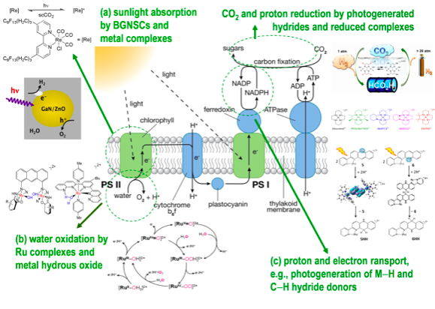
Photosynthesis
https://www.youtube.com/watch?v=sQK3Yr4Sc_k
The solar cell of nature
Terrible complex chemically
Not very efficient!
Built every spring, discarded in autumn
How much energy coming out of a leave?
How much energy “is” a tree?

Slide 27
Energy…
All energy comes from the Sun - or other stars
Hydrogen burning into Helium or beyond
Hydrogen Lab - RDM Hogeschool Rotterdam https://www.rdmcoe.nl/themas/energytransition/
Nuclear energy? - Uranium made in distant supernovas
Fuel - burning - heat - pollution (oil, coal)
Electricity - has to be “generated” (from oil, coal)
“Alternative energy”
http://www.top-alternative-energy-sources.com
Maffia (politics, ways to win a war, ways to dominate, ways to get rich)
Power companies monopoly, subsidies for Wind Turbines, seed oils, electric cars
Fuel can be stored, oil was “stored” by the Earth
Electricity cannot be stored easily

Slide 28
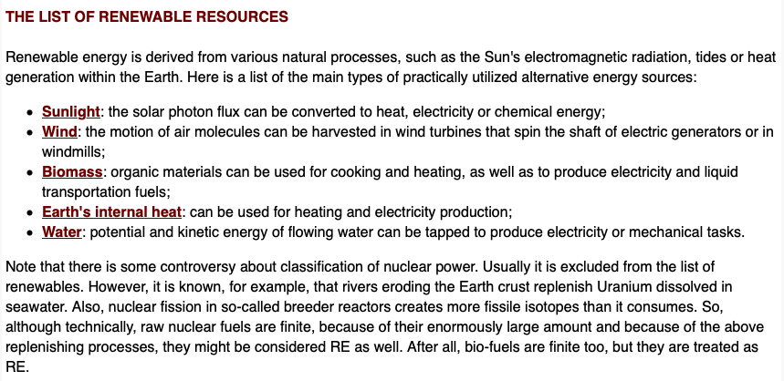
“Big energy”
Eg from http://www.renewable-energysources.com

Slide 29
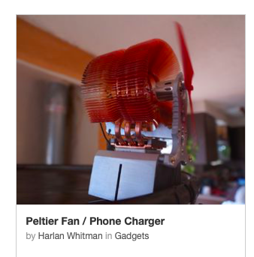
(Very) Small energy
Mud cell battery
Electricity from plants, algae
Electricity from pollution
Energy Harvesting
Mud cell for example https://www.instructables.com/id/An-Easy-Cheap-Soil-based-Microbial-Fuel-Cell/
Small solar cell, wind turbine
Harvesting vibrations
Extracting warmth from your body
Harvesting on your muscles
Static Electricity

Slide 30
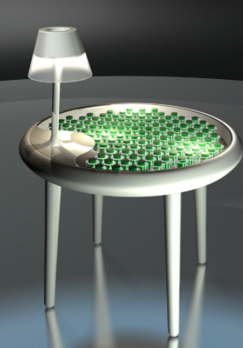
Study Examples
Moss table
http://www.designindaba.com/articles/creative-work/algae-energy-london2011
Cell Phone Charging dress
Pauline van Dongen
Complexity of energy notions in the body

Slide 31
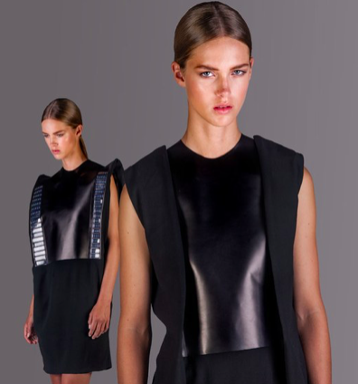
Solar cell …dress…flip flap
(Pauline van Dongen)

Slide 32
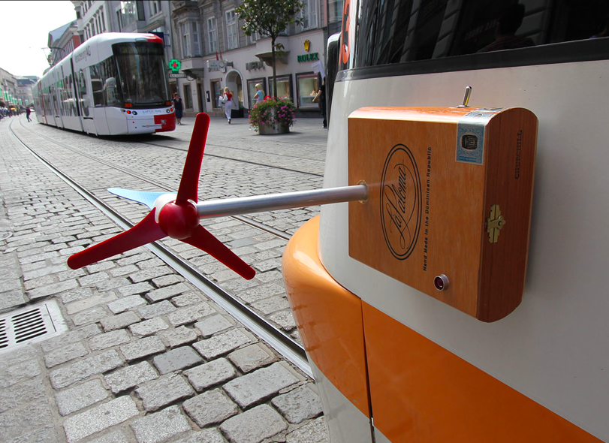
Energy “Parasite”
Looking for places where energy is wasted and then take advantage of this.
http://www.energyparasites.net

Slide 33
Static Electricity: Paper energy
https://makezine.com/projects/power-paper-circuits-with-static-electricity/

Slide 34
Physics of energy:
Heat and Energy

Slide 35
Compare energies
Consider the energy required to heat 1.0 kg of water from 0 ºC to 100 ºC when the specific heat of water is 4.19 kJ/kgºC:
Q = (4.19 kJ/kgºC) (1.0 kg) ((100 ºC) - (0 ºC))
= 419 (kJ) equivalent to 100 kcalori (food units)
Banana 93 kcal = 390 kJ
One banana = boiling water for one cup of tea (1/4 of a liter)
lifting a mass of 100 kg an elevation of 10 m = 9810 J = 10 kJ
Pro 20 climbing stairs = 5 kcal = 20 kJ.
15 Minutes Walking around 50 kcal = 200 kJ
Smart phone battery 3300 mAH -> 4Volt * 3.3A * 3600 (seconds)
= 47.5 kJ roughly equal to about 1/8 of a banana
The energy by mass of gasoline is over 12,000Wh/kg. In contrast, a modern Li-ion battery only carries about 200Wh/kg; (https://batteryuniversity.com/index.php/learn/article/comparing_the_battery_with_other_power_sources
But there are all sorts of “problems”, you never get full energy out of something!

Slide 36
Assignment
Make a list of devices which use energy in your surroundings, room, house.
Try to figure out (checking labels etc) what kind of energy, how much, how frequent.
Also look at food energy and muscle energy, bicycle walking.
Try to find out the source of the energy, and the source of the source of energy (electricity by oil, or wind…)

Slide 37
Knowledge by doing
Some formula’s of electronics
V = I * R
Power = V * I, voltage times current
The notion of “load”
Joule Watt Calori comparisons

Slide 38
Tools
Calculations
Volt meter for measuring VOLT and CURRENT

Slide 39
Techniques
Basic Electronics
Circuit
Parallel and in series
LED at 3 Volt?

Slide 40
Speculative design
Ethics of a designer
Technology optimism
Stay critical

Slide 41
Human Harvesting
One hour walks can be relaxing and you can burn 200+ calories

Slide 42
Chinese gadget investigated

Slide 43
Leaf energy
https://cleantechnica.com/2013/05/11/harvesting-electricity-from-plants-plant-based-energy-generation/

Slide 44
Solar energy calculator
Experiment with a solar cell
Position on the Earth
Orientation
Sun in the sky, season
https://eu-solar.panasonic.net/nl/zonne-energiecalculator.htm

Slide 45
Energy stored in twisted rubber band
https://www.scientificamerican.com/article/bring-science-home-rubber-bands-energy/
Paper plane shooting and energy

Slide 46
Muscle energy
Complicated muscle energy: https://www.quora.com/How-is-energy-stored-in-muscles
Energy of a work out - running
Workout device as energy source
Harvest some muscle power into electricity?

Slide 47
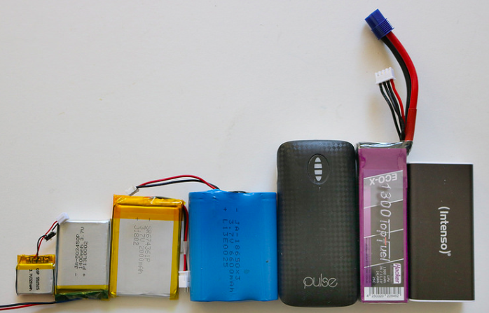
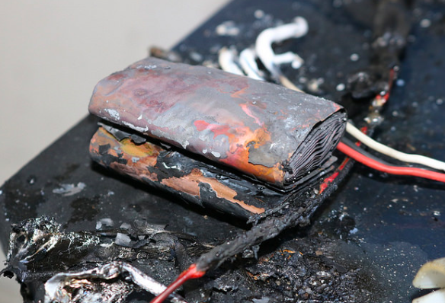
Batteries - power banks
For example: https://learn.adafruit.com/all-about-batteries/power-capacity-and-power-capability
There are many batteries, big and small, it is important to choose the right battery for your project: https://learn.adafruit.com/all-about-batteries/how-to-pick-the-right-battery-for-your-project
Technical details!

Slide 48
Suggestions - Assignments
Experiments and …
find-make some design application
Investigate/make a charging system with the bicycle dynamo and charging device
Bigger structure, metal workshop, welding, construction (Spatial? - Product?)
Investigate/make a mud cell - apply this for example in a poster/illustration/comic (?)
Investigate/make a fruit cell (potato, banana…..), why not in a garment - fashion (?)
(Re-) Investigate/make on of your own projects - Define your own energy project
Play garden, sport school toys, energy investigation, Brother knitting machine…any machine in the school, harvest vibrational energy … Redesign
Parasite devices, eating discarded energy… (Product?)
Investigate/make your wind turbine
Harvest your own muscle power, walking power, work-out
Investigate - improve - rebuild - redesign, Chinese gadget, IKEA dynamo, or others
Paper power (electro static energy) to flash an LED, for example: https://www.instructables.com/id/The-Worlds-Simplest-Electrostatic-Machine/ (Graphical - poster design ?)
https://makezine.com/2013/10/10/new-technology-paper-generators-harvest-static-electricity/

Slide 49
Peltier element - Joule Thief
https://hackaday.com/2010/01/05/generate-electricity-with-a-candle/

Slide 50
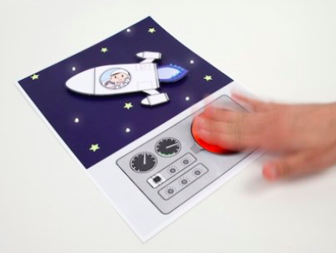
Paper energy
https://makezine.com/projects/power-paper-circuits-with-static-electricity/
https://makezine.com/2013/10/10/new-technology-paper-generators-harvest-static-electricity/

Slide 51
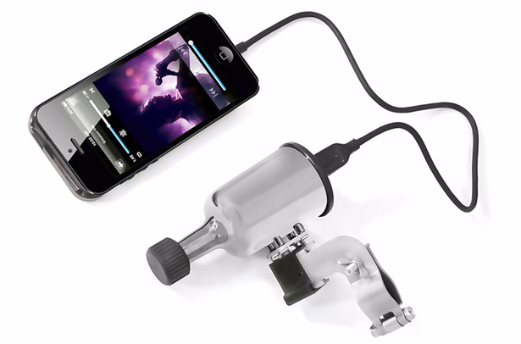
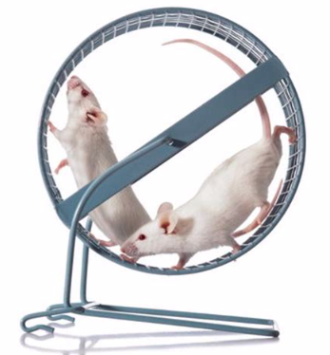
Muscle charger
Instead of the mice…
A human being :-)

Slide 52
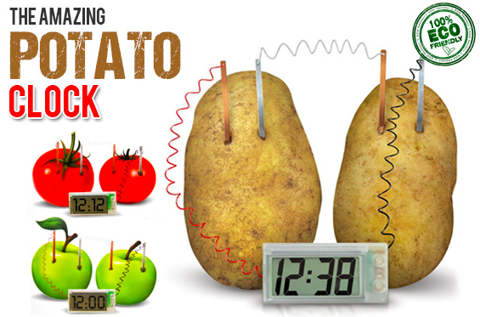
Potato cell
It works….but then…
Challenge: ”do” something (more) with it!
And i think this is
Not
Eco friendly…

Slide 53
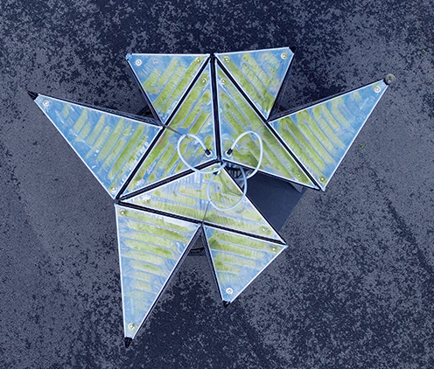
Mud Cell…Plant cell…Algae
Does this work?
If it worked, say… design something with this
http://www.ecologicstudio.com/v2/projects.php?idsubcat=59

Slide 54
Muscle Harvesting Devices
Design - make challenge
https://www.bionic-power.com
Can you do this with the “Chinese” gadget?

Slide 55
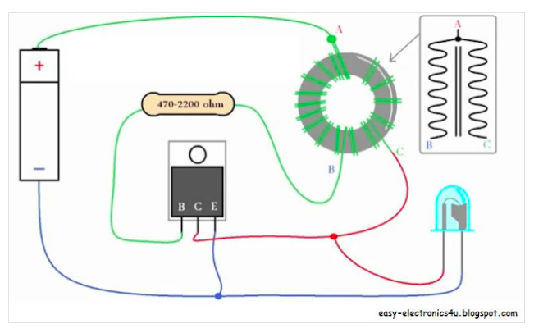
Joule Thief & soldering
“boost” low voltage to a higher voltage
http://www.vk6fh.com/vk6fh/joulethief.htm
But … there is some “attitude” with the windings…

Slide 56
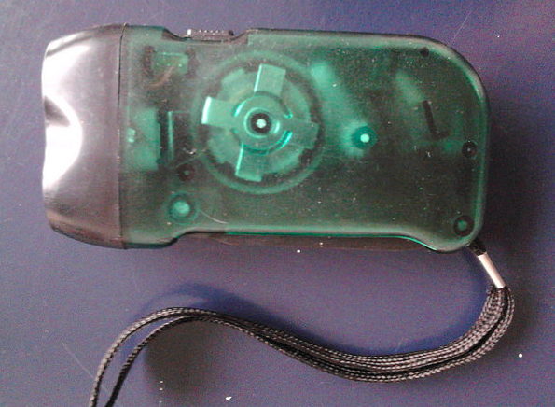
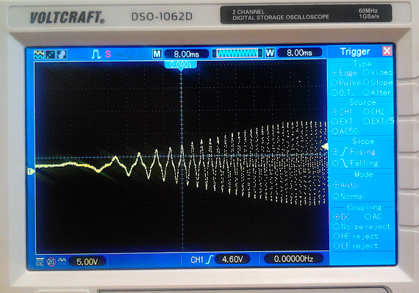
Chinese gadget (1 euro)
https://energyharvestingresearch.wordpress.com/2014/11/30/experiments-with-the-chinese-gadget-muscle-power-and-ltc-3588/
https://energyharvestingresearch.wordpress.com/2014/11/06/deep-analysis-of-a-chinese-harvesting-gadget/
Hand muscle power, and wasting half of the energy

