Slide 1
Joule Thief
Beam 2019

Slide 2
Transistor
Switch
Amplifyer
The history of how the transistor was invented is fantastical: https://www.youtube.com/watch?v=WiQvGRjrLnU
The way the transistor was produced in Japan is fantastical: https://www.youtube.com/watch?v=ihkRwArnc1k
We use this incredible devise as a switch…

Slide 3
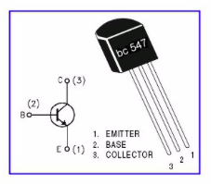
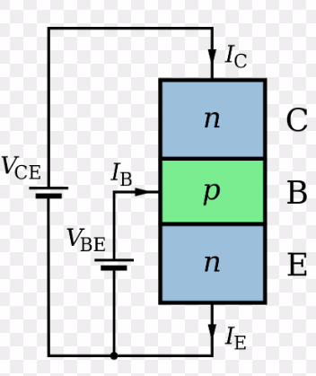
NPN transistor
Middle leg is “BASE”
Flat side up: right leg = “EMITTER”
Goes to GROUND, gnd, minus
Left leg = “COLLECTOR”

Slide 4
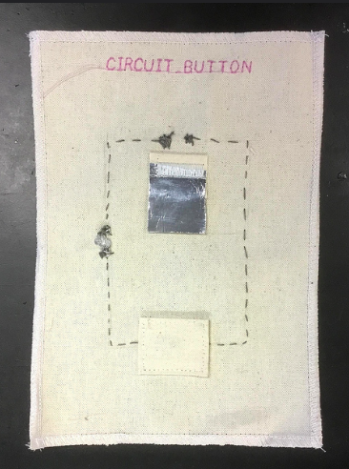
Fabric switch

Slide 5
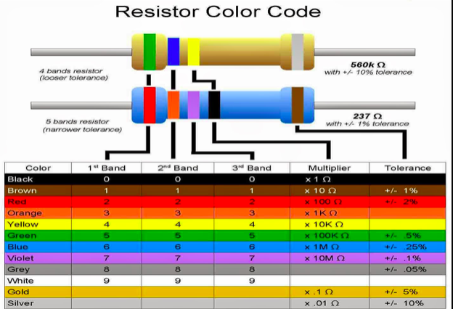
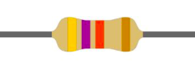
Resistor 1K
Resistor limits the current
V = I x R. 3V = 1 x 3, 3V = 3/1000 x 1000
But also the power in the circuit: P = V x I

Slide 6
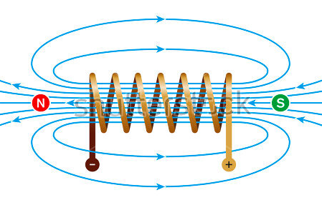
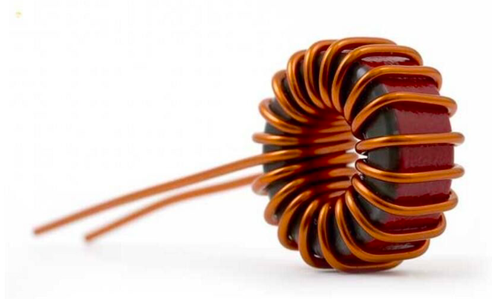
Coil
Mysterious element
A coil can store energy
A coil generates a magnetic field
A magnetic field in a coil tries to maintain itself

Slide 7
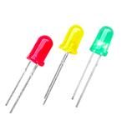
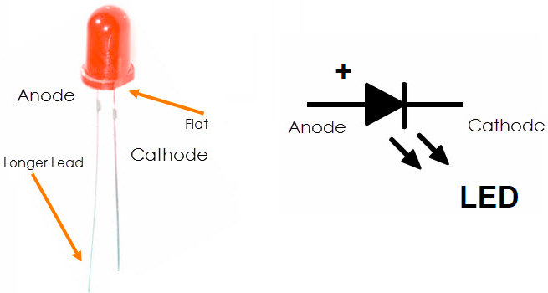
LED
This gives light
It is also a “DIODE”
One direction element
Voltage in the right direction, light
Voltage in the wrong direction, big resistor

Slide 8
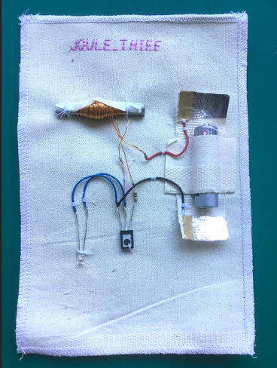
Joule Thief swatch

Slide 9
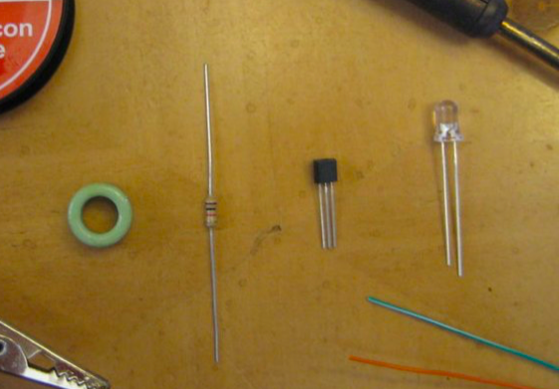
All parts but the battery

Slide 10
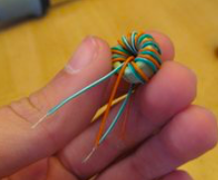
Wind the coil yourself
We use copper wire…this is insulated
They “say” 20 rounds, but I took 50-100
A double wire: start with the middle, wind in same direction
Copper coil at the ends must be “cleaned”, “scraped”

Slide 11
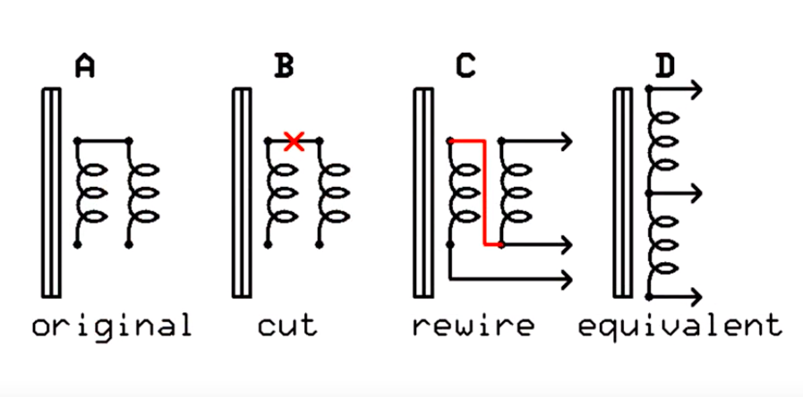
Rewiring

Slide 12
Connecting
Coil has 4 wires sticking out
“Middle” two must be connected (soldered), and to PLUS
The other wire:
One to the resistor to the BASE of the transistor
The other to the COLLECTOR
The LED should be “REVERSED” on the transistor

Slide 13
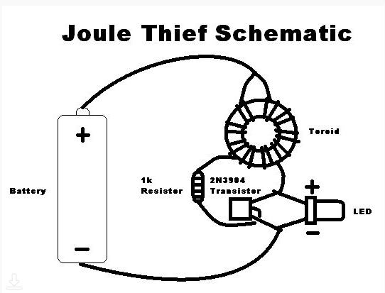
Schematic

Slide 14
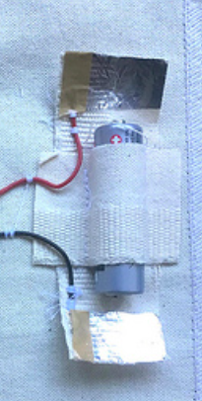
We make a battery holder
Battery holder from aluminum tape
Connect the wires to it (tape or solder)
This battery holder is also the switch!

Slide 15
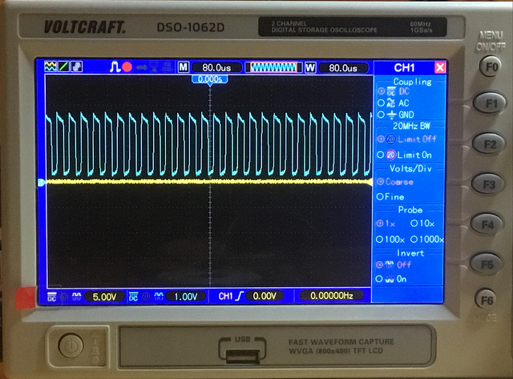
Switching made visible

